Slide 1
Researching Games

Slide 2
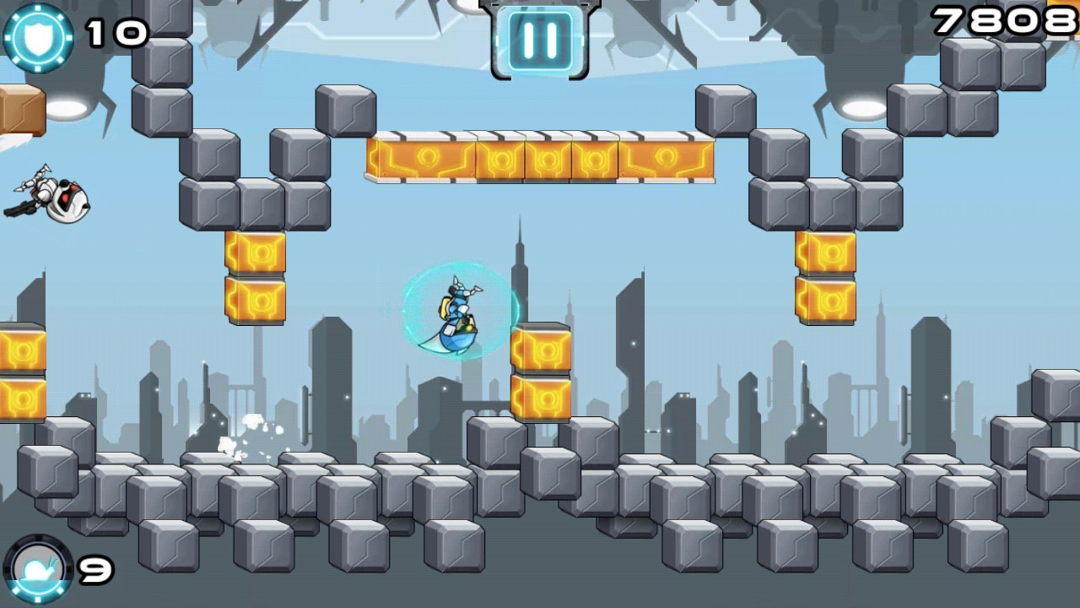

Gravity guy
Gravity Guy is a game that removes the jump mechanic and replaces it with a gravity mechanic that players can use to overcome obstacles and gaps.

Slide 3
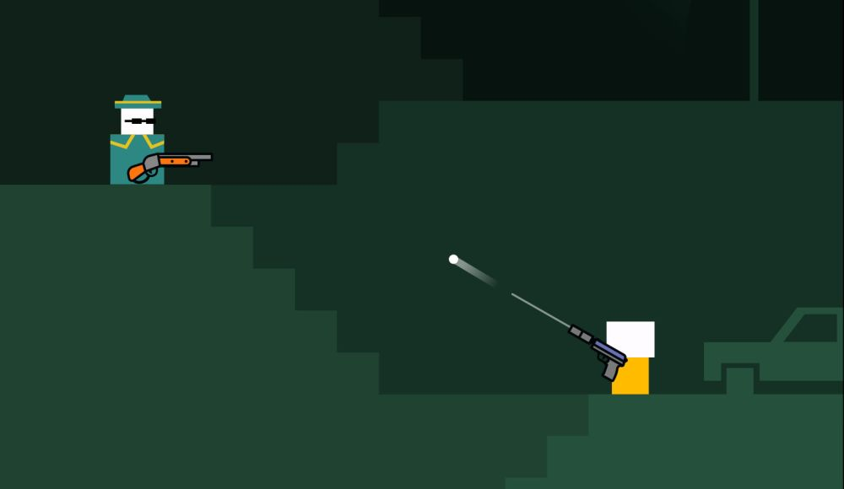
Mr gun
Mr Gun is a Shooter/Platformer game that removes movement and Free Aiming and is replaced with a twitch mechanic which requires players to press when the gun is aimed towards the enemy.
Once the player kills an enemy they are moved up a platform to reach the end goal.

Slide 4
Game Ideas

Slide 5
Shooter w/o movement
Mechanic Taken Away:
Movement
Mechanic Replacing Movement:
The player will use the recoil of the guns to move about the level.
Different guns will have different recoil effects e.g shotguns have more recoil than a handgun.
Objective:
Shoot the enemies to progress through the level.

Slide 6
Themes
Underwater Creatures
Bugs
Domestic Animals

Slide 7
Platformer w/o jumping
Mechanic Taken Away:
Jumping
Mechanic Replacing Jumping:
Building ladders to move to the next platform
Judging distances of the gaps and creating a ladder that is long enough but not too long
Objective:
Players must build a ladder that reaches the window, however the ladder cannot be too long otherwise it will break and it cannot be too short. There will be a safe zone so that players are not punished.
Once you reach the next platform you earn a point.
Players will keep progressing until they fail a platform and then have to start again.

Slide 8
Themes
Firefighting
Olympic Pole Vaulting
Throwing A Ladder from a Helicopter to A Civilian

Slide 9
Idle game w/o tapping
Mechanic Taken Away:
Tapping
Mechanic Replacing Tapping:
Players will shake the phone, using the gyroscope
Objective:
Players will shake their phone to be rewarded with a multiplier that speeds up investments and business’.
Players will purchase and upgrade business’ to collect money and progress through the game.

Slide 10
themes
Snowglobe
Bar/Restarurant (Cocktail shaker)
Shaking someones hand. The longer you shake the more awkward it gets and you gain better multipliers

